Slide 1


CITS1003 Introduction to Cybersecurity [9] Practical Applications of AI in Cybersecurity
Larry Huynh, S1 2023

Slide 2
AI in Cybersecurity: ToC
Use of AI in both:
Potentially causing harm by malicious use, and;
solving practical cybersecurity issues
Adversarial attacks on neural networks
Deepfakes and detection
Rumour detection and rumour generation
Large Language Model exploits
Notes:
Introduce yourself
Trying to highlight some research work done at uwa
Ask if they've all seen the pre-lecture videos
If not, brief ML pipeline
Content has changed in the last year!

Slide 3
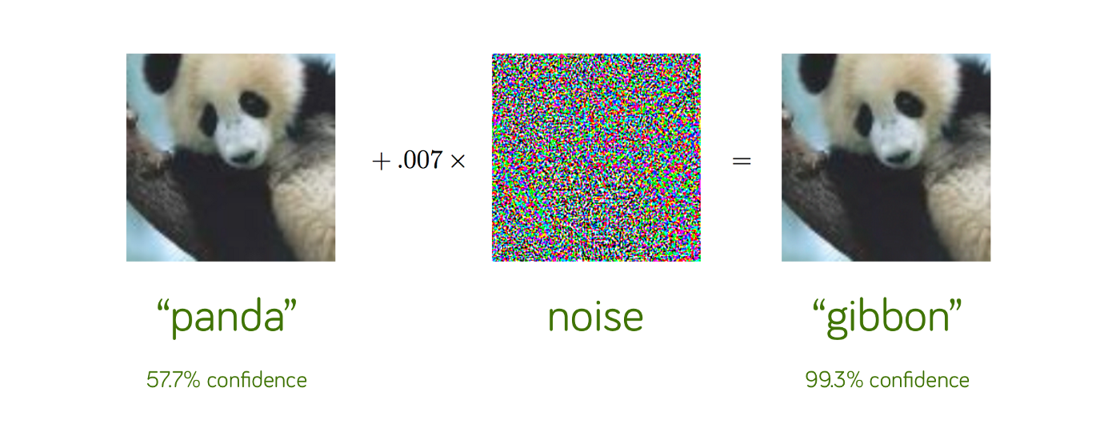
Adversarial Attacks
A non-visible alteration of an image that causes the neural network to misclassify the image
[1]

Slide 4
Adversarial Attacks
Threat of Adversarial Attacks on Deep Learning in Computer Vision: A Survey (2018) – N. Akhtar, A. Mian (UWA)
Many forms of perturbations possible
Some perturbations can even work universally – against any C.V. AI model
Adversarial attacks are a real threat to AI systems, with detrimental consequences

Slide 5
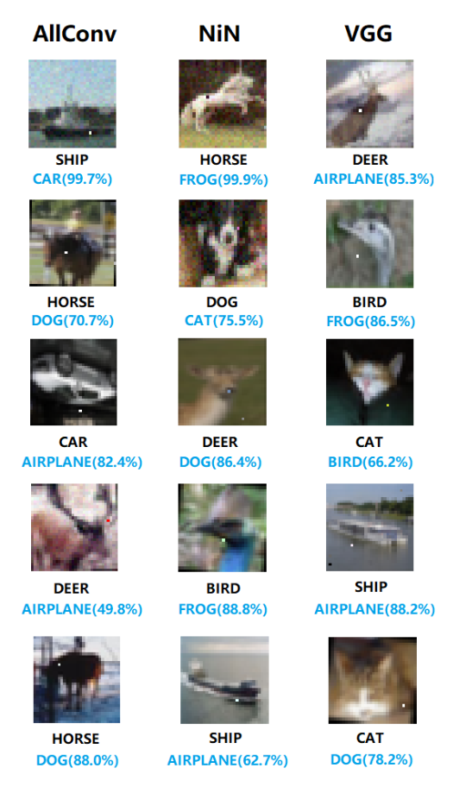

Adversarial Attacks
One-pixel Attacks
Extreme case: only 1 pixel in the image is changed to fool the classifier
Results showed 3 different models were fooled on 70.97% of test images
97.47% average confidence on false classification
[3]

Slide 6
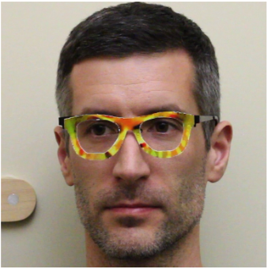
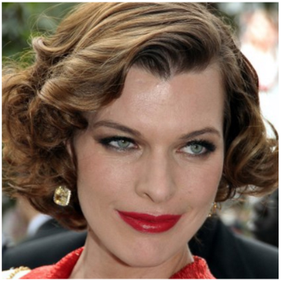
Adversarial Attacks: Physical Attacks
“Accessorize to a Crime”
Developed 3D printed eyeglasses to fool facial biometric systems
Attacks are physically realizable and relatively inconspicuous
=
[4]
[4]
“Milla Jovovich”
Notes:
-

Slide 7
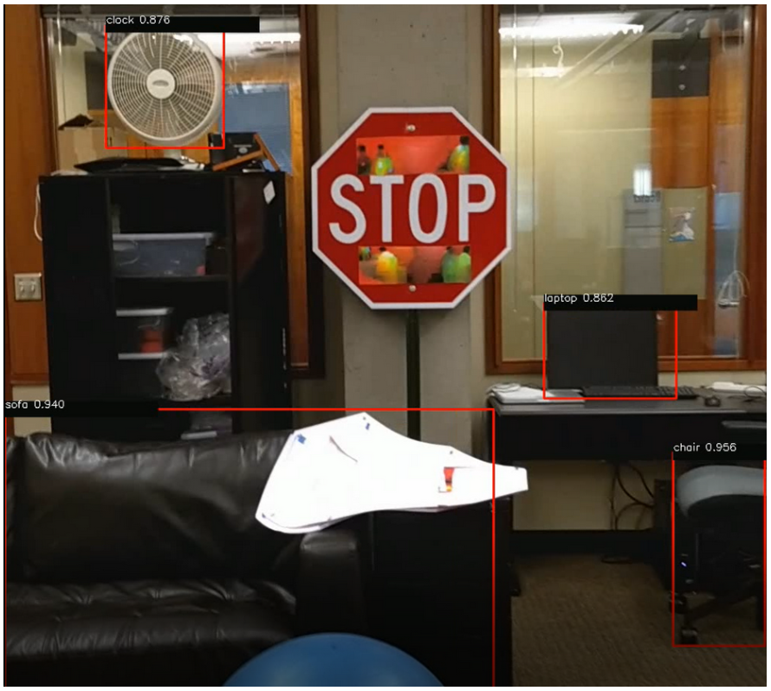
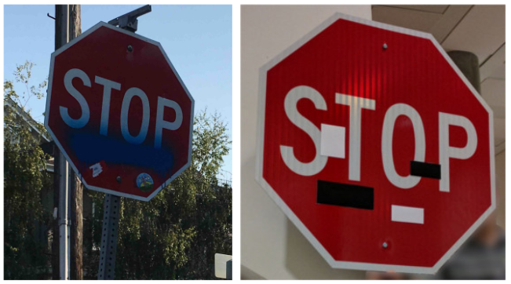
Adversarial Attacks: Physical Attacks
Road Sign Misclassification
[5]
[6]

Slide 8
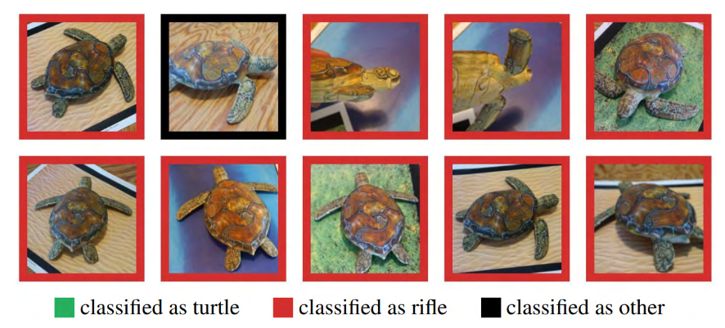
Adversarial Attacks: Physical Attacks
Adversarial 3D Objects
3D printed objects constructed that are adversarial over an entire distribution of image/object transformations
[7]

Slide 9
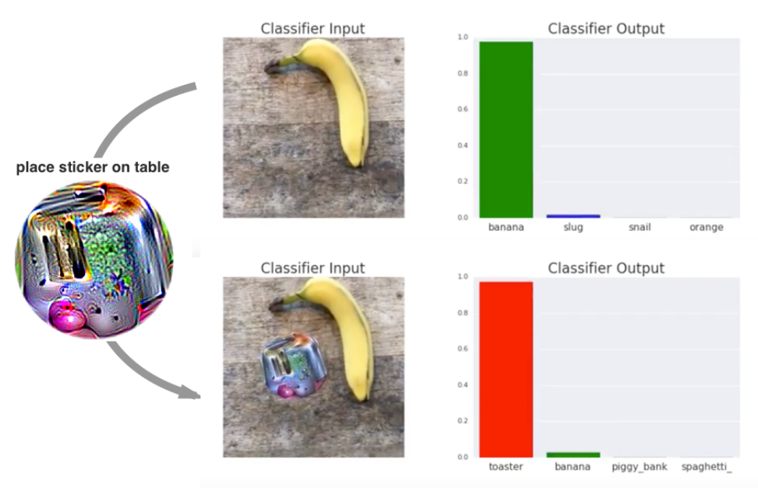
Adversarial Attacks: Physical Attacks
Adversarial Patch
Sticker designed so that when placed into the scene, the object is misclassified
Sticker is publicly available for download and print
[8]

Slide 10
Adversarial Attacks: Why is AI Susceptible?
Let’s play a game!
"Classify" the given hand-drawn digit (0, 1, 2, …, 9)
You must try and classify the digit
[9]

Slide 11
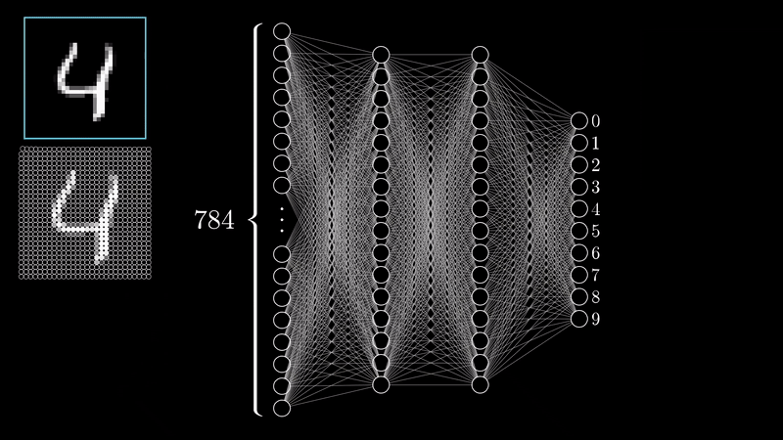
Adversarial Attacks: Why is AI Susceptible?
Classifying hand-written digits, neural network edition!
[9]

Slide 12
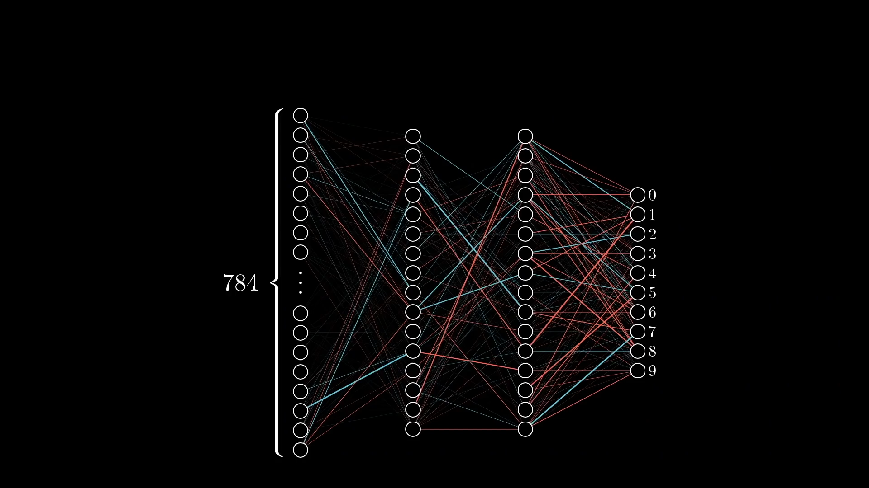
Adversarial Attacks: Why is AI Susceptible?
Models do their best to tell you what they know, even if what it’s telling you is nonsense!
[9]

Slide 13
Adversarial Attacks
Should we be concerned about adversarial attacks?
How concerned should we be about adversarial attacks affecting real-world systems?

Slide 14
Adversarial Attacks
Defences?

Slide 15
Adversarial Attacks
Defences:
Modify AI systems to make them harder to attack
Train on adversarial inputs
Model input constraints
Use more robust algorithms
Physical barriers to attack
Manual monitoring of system use, vetting, etc.
Increased digital security for some applications (MFA)

Slide 16
Adversarial Attacks
Challenges in Implementing Defences Long-term?

Slide 17
Adversarial Attacks
Challenges in Implementing Defences Long-term:
Arms race in developing defences for some applications
Trade-off between security and useability
Costs incurred in implementing defences
Updates may introduce new vulnerabilities

Slide 18
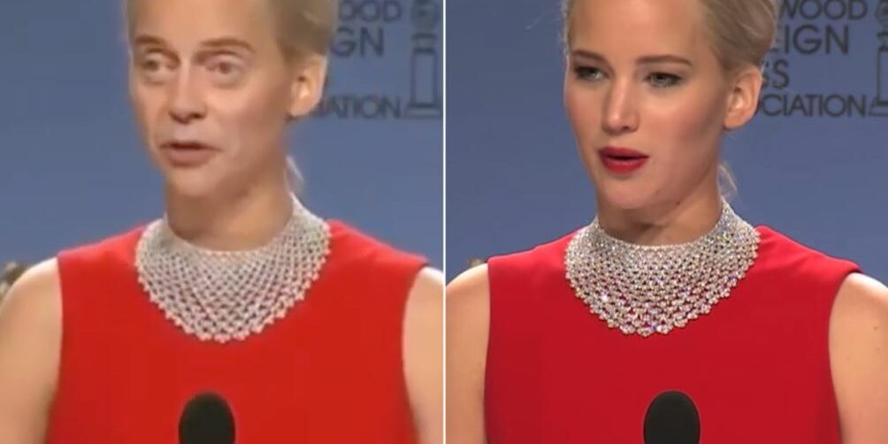
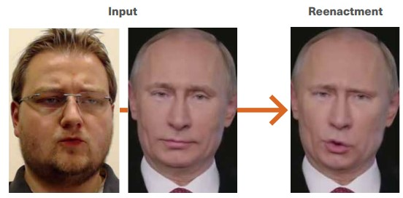
Deepfakes
Synthetic media generated by AI methods, used to create falsified content: faces, body, speech, emotions, etc.
Face Swapping
Re-enactment
[10]
[11]

Slide 19
Deepfakes
Speech Synthesis: creating realistic audio of someone's voice via AI or computer-generated methods
High quality synthesis has never been more accessible
Let’s speedrun deepfaking a voice with ElevenLabs
You will need:
An email account
A >1 minute recording of the target voice
$1 AUD

Slide 20
Deepfakes
What are some harmful uses of Deepfakes?
What are the consequences of this usage?

Slide 21
Deepfakes
What are some harmful uses of Deepfakes?
What are the consequences of this usage?
Legitimize misinformation
Delegitimize information
Misrepresentation of individuals
Effects on public opinion
Tools for coercion, blackmail, etc.
Depends on who creates the deepfakes and for what purpose

Slide 22
Deepfakes: Demo!
First Order Motion for Image Animation (2019) _{[15]}
Nowadays, deepfakes are easy to create!
Deepfake tools are more accessible than ever.
Some are for fun, some are for "research" (and work extremely well…)
Resource and expertise limitations are becoming irrelevant.
Human detection of deepfakes is becoming increasingly difficult.

Slide 23
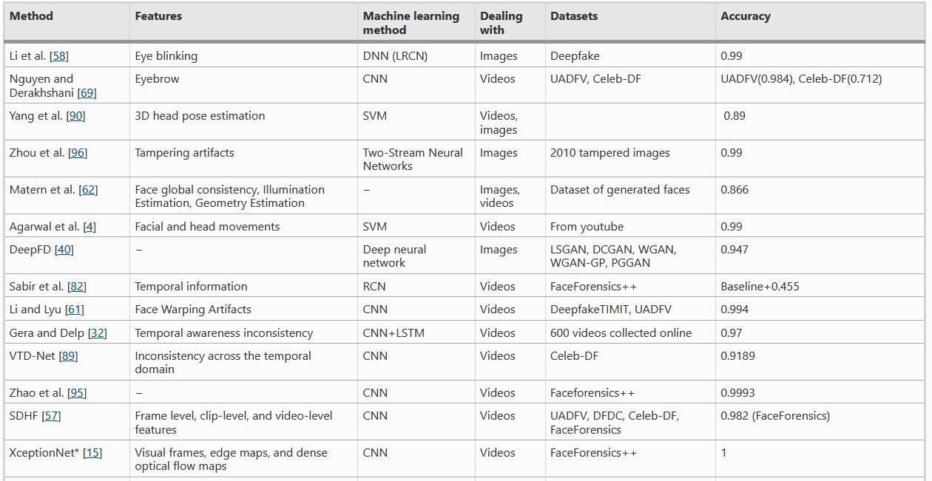
Deepfakes: Detection
Train an AI model to try detect these features.
[12]

Slide 24
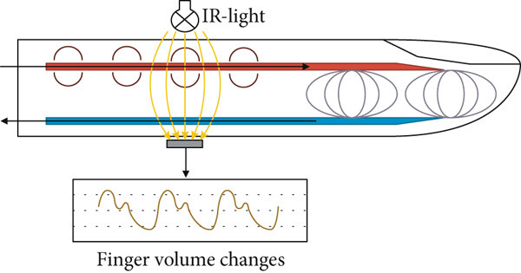
Deepfakes: Detection
Identifying Deepfakes By Extracting Pulse Signals (2020) – R. Hodgson, UWA
Deepfake detection using photoplethysmography
[13]

Slide 25
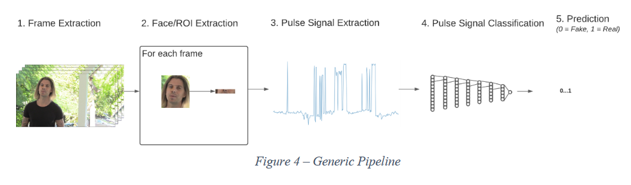
Deepfakes: Detection
Identifying Deepfakes By Extracting Pulse Signals (2020) – R. Hodgson, UWA
Deepfake detection using photoplethysmography

Slide 26
Deepfakes
Deepfakes have positive applications too!
Art: virtual exhibits, bringing art to life
Film: de-aging actors
Medicine: generate synthetic data to boost imaging and ailment detection

Slide 27
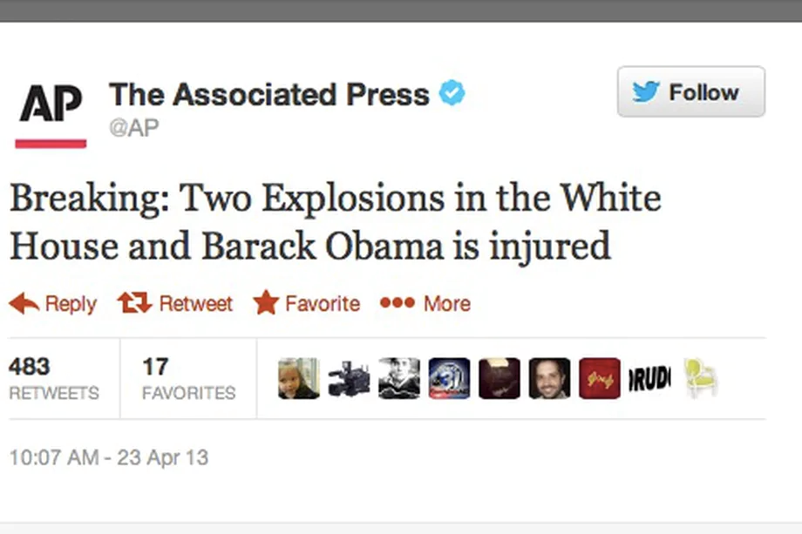
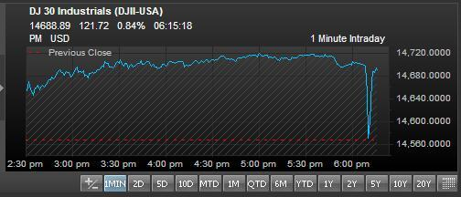
Rumour Detection
Rumours:
Unverified pieces of information, reporting uncertain or doubtful truth
Rumours can have damaging consequences to social, economic, political structures
2013: Post from hacked news account causes US stock market crash
[13]

Slide 28
Rumour Detection
Rumour Detection:
Determining the veracity value of a rumour
Automate the process via AI methods
Feed rumour and non-rumour data into AI models → try to learn rumour representations from text and other metadata

Slide 29
Rumour Detection: Limitations
Training AI models requires large amounts of data​
Getting labelled data is challenging​
AI-based rumour detection suffers over new, unseen rumours (out-of-domain contexts)
How can we get labelled data more effectively and efficiently?
How can we make better models that are agnostic to emerging events?

Slide 30
Rumour Generation
Propose the Rumour Generator
Force current detection to learn stronger representations
Help pre-empt events
Augment datasets
ARGH!: Automated Rumour Generation Hub (2021) – L. Huynh, T. Nguyen, J. Goh, J. Hong, H. Kim
ARGH! Demo

Slide 31
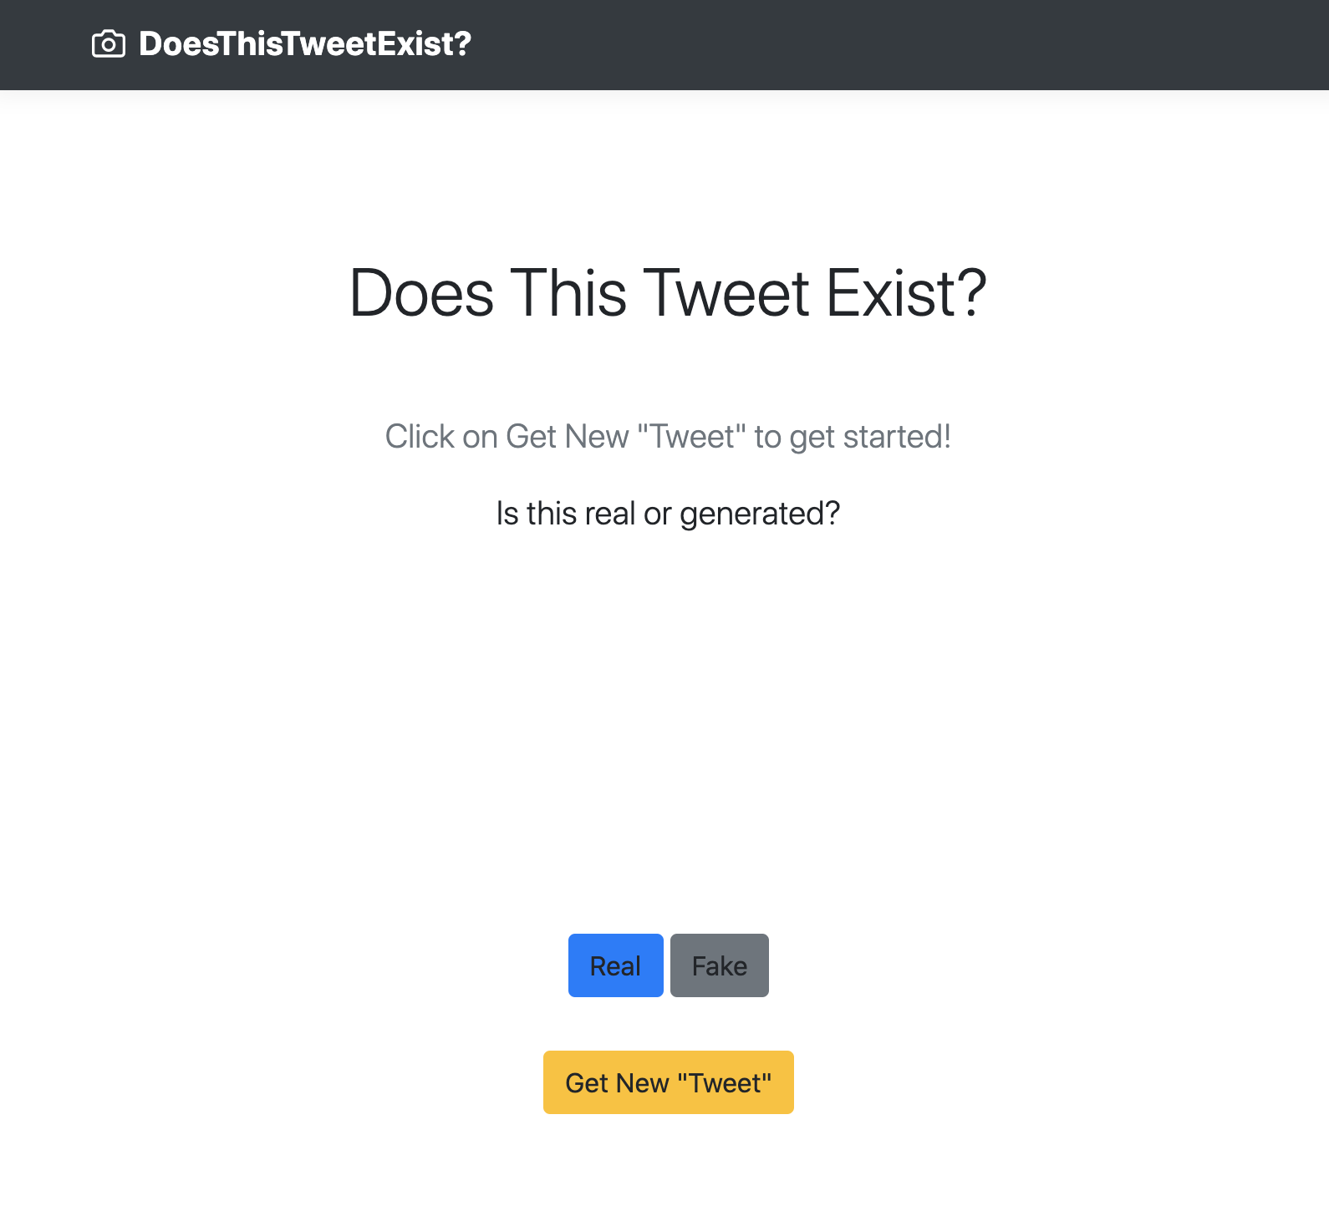

Rumour Generation
Doesthistweetexist?
https://doesthistweetexist.vercel.app

Slide 32
ARGH!: Experiments
Experiment 1: Human Evaluation Survey
Determine whether given tweet is rumour or non-rumour​
3 topics:​
COVID-19, 2020 US Election, Beirut Explosion​
2332 responses

Slide 33
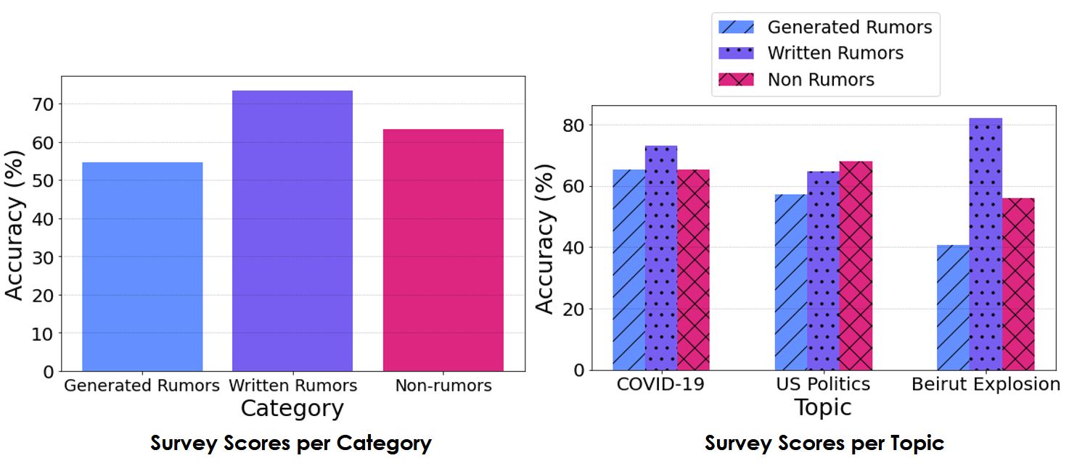
ARGH!: Experiments
Generated Rumour Evasiveness:​
Real rumours: +18.87% ​
Non-rumours: +8.69%

Slide 34
Rumour Generation: Outcomes
Bolster rumour detection methods:
Populate more training samples
Produce unseen topic datasets
Models consequently learn a greater range of rumour representations
Do the existence of rumour generation frameworks cause concern?

Slide 35
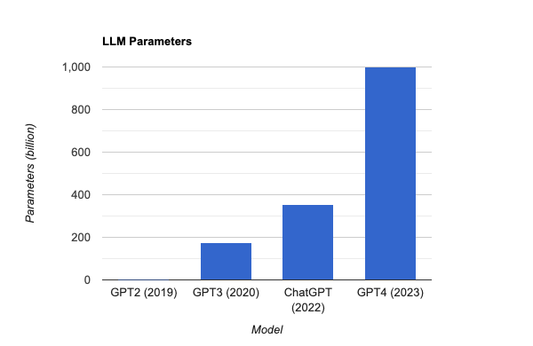
Rumour Generation: Large Language Models
ARGH! uses GPT-2; we’re up to GPT-4 now.
Parameters ≈ Ability/capabilities of the model
Just 1.5b!

Slide 36
ChatGPT: Prompt Injections
Vulnerability in prompt-based language models
Model adjusts behaviour through conversation- examples/instructions given via prompts
Attackers inject malicious instructions into input fields, causing unexpected actions.
Vulnerability is inherent: the combination of pre-written instructional prompt with untrusted input from elsewhere; that's just how these models work!
Jailbreak Chat

Slide 37
ChatGPT: Prompt Injections
Why do they work?
We don’t know yet!
How practical are these attacks? Can they really be used maliciously?
Security concerns are real!
Turning Bing Chat into a Data Pirate _{[16]}

Slide 38
AI: Ethics and Implications
AI Systems are tools for use in applicable settings
Tools are created with certain intentions in mind
The use, or misuse, of these tools is up to the end user
Regulations, limitations on the use of AI?
Is AI technology progressing too quickly?

Slide 39
References
Adversarial Attacks in Machine Learning and How to Defend Against Them. (2022). Retrieved 16 May 2022, from https://towardsdatascience.com/adversarial-attacks-in-machine-learning-and-how-to-defend-against-them-a2beed95f49c
Akhtar, N., & Mian, A. (2018). Threat of Adversarial Attacks on Deep Learning in Computer Vision: A Survey. IEEE Access, 6, 14410-14430. doi: 10.1109/access.2018.2807385
Su, J., Vargas, D., & Sakurai, K. (2019). One Pixel Attack for Fooling Deep Neural Networks. IEEE Transactions On Evolutionary Computation, 23(5), 828-841. doi: 10.1109/tevc.2019.2890858
Sharif, M., Bhagavatula, S., Bauer, L., & Reiter, M. K. (2016, October). Accessorize to a crime: Real and stealthy attacks on state-of-the-art face recognition. In Proceedings of the 2016 acm sigsac conference on computer and communications security (pp. 1528-1540).
Eykholt, K., Evtimov, I., Fernandes, E., Li, B., Rahmati, A., Xiao, C., ... & Song, D. (2018). Robust physical-world attacks on deep learning visual classification. In Proceedings of the IEEE conference on computer vision and pattern recognition (pp. 1625-1634).
Seita, D. (2022). Physical Adversarial Examples Against Deep Neural Networks. Retrieved 16 May 2022, from https://bair.berkeley.edu/blog/2017/12/30/yolo-attack/
Athalye, A., Engstrom, L., Ilyas, A., & Kwok, K. (2018, July). Synthesizing robust adversarial examples. In International conference on machine learning (pp. 284-293). PMLR.
Brown, T. B., Mané, D., Roy, A., Abadi, M., & Gilmer, J. (2017). Adversarial patch. arXiv preprint arXiv:1712.09665.

Slide 40
References
3Blue1Browns. (2017, Oct 17). Gradient descent, how neural networks learn | Chapter 2, Deep learning [Video]. YouTube. https://www.youtube.com/watch?v=IHZwWFHWa-w
The AI tech behind scary-real celebrity 'deepfakes' is being used to create completely fictitious faces, cats, and Airbnb listings. (2022). Retrieved 16 May 2022, from https://www.businessinsider.com/deepfake-tech-create-fictitious-faces-cats-airbnb-listings-2019-2
Weaponised deep fakes. (2022). Retrieved 16 May 2022, from https://www.aspi.org.au/report/weaponised-deep-fakes
Zhang, T. (2022). Deepfake generation and detection, a survey. Multimedia Tools and Applications, 1-18.
Kuncoro, C., Luo, W. J., & Kuan, Y. D. (2020). Wireless photoplethysmography sensor for continuous blood pressure biosignal shape acquisition. Journal of Sensors, 2020.
The Verge. 2022. AP Twitter account hacked, makes false claim of explosions at White House (update). [online] Available at: <https://www.theverge.com/2013/4/23/4257392/ap-twitter-hacked-claims-explosions-white-house-president-injured> [Accessed 16 May 2022].
Siarohin, A., Lathuilière, S., Tulyakov, S., Ricci, E., & Sebe, N. (2019). First order motion model for image animation. Advances in Neural Information Processing Systems, 32.
Greshake, K., Abdelnabi, S., Mishra, S., Endres, C., Holz, T., & Fritz, M. (2023). More than you've asked for: A Comprehensive Analysis of Novel Prompt Injection Threats to Application-Integrated Large Language Models. arXiv preprint arXiv:2302.12173.

